Slide 1

Welcome Big Red Parents!
Tips on Helping your Student Transition to
High School Successfully
Provide love & understanding – express your support and LISTEN to their concerns | Help your student get organized and use an agenda routinely to mark down assignments | Help your student establish a distraction-free place to study with a regular study routine
Set clear limits and establish firm, but fair expectations. Role model good behaviors including attending school every day and being on time. | Discuss their four year and beyond plan – college, trade or specialty school? – talk to the school counselor | Communicate with teachers: attend open house, conferences and utilize their email or websites. Login to Parent Portal &Request access to student's Schoology pages
Provide nutritious meals & encourage regular exercise & consistent, quality sleep | Talk about the dangers of alcohol, tobacco & other drug use & social media; role play these scenarios & discuss consequences | Get involved & encourage your student to do the same: enjoy all that Chippewa Valley High School offers!

Slide 2
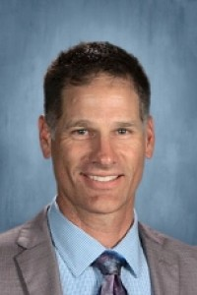
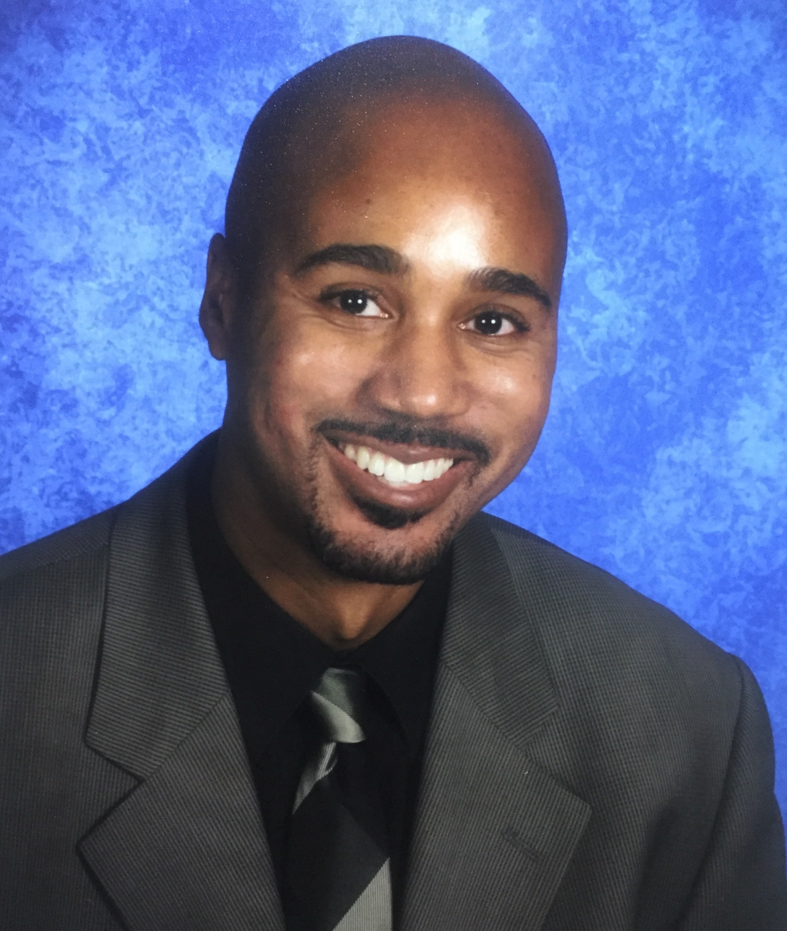
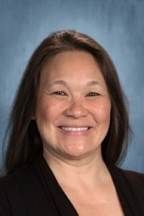
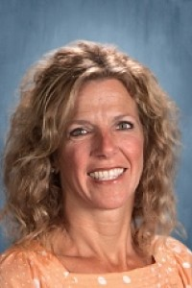
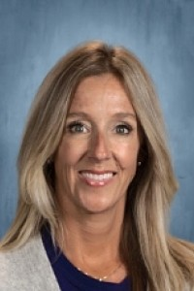

Welcome Future Ninth Grade Chippewa Valley Parents!
What Will be Covered tonight:
Introductions
Video tour of 9th Grade Center:
https://youtu.be/aps9P311S_8?si=T6FSCmLxYb-SF8FG
Graduation Requirements
NWEA data/Class Placement
Scheduling/Course Offerings
Study Skills & Help Available
Get Involved! Clubs, Organizations & Athletics
Communicate!!
Visit curriculum informational tables once we wrap up ☺
Mr. Distelrath
CVHS Campus
Principal
Mr. Williams CV9 Principal Mrs.VanOphem CV9 Asst. Principal
Mrs. Wall Mrs. Frohock Dr. Lawrence
CV9 Counselors
Notes:
Introductions:

Slide 3
GRADUATION REQUIREMENTS
English 4.0 (Credits/Years)
Math 4.0
Science 3.0
Social Studies 3.0
World Language 2.0*
Visual, Performing, App. Arts 1.0
Physical Education 0.5
(P.E. clothes highly recommended – Chippewa gray t-shirt and black shorts available for purchase)
Health 0.5
Electives 4.0
TOTAL 22.0
* One credit of World Language requirement can be substituted with completion of a Career Tech Ed Program of Study or an additional credit of Visual, Performing or Applied Arts.

Slide 4
TYPICAL 9th Grade Schedule
First Semester | Second Semester
English 9A or Advanced English 9A | English 9B or Advanced English 9B
Biology I or Honors Biology I | Biology II or Honors Biology II
Global History I or AP World History I | Global History II or AP World History II
Math (Algebra, Accelerated Algebra, Geometry, or Accelerated Geometry) | Math (Algebra, Accelerated Algebra, Geometry, or Accelerated Geometry)
Physical Education 1 or Health (.5 credit) | Health or Physical Education 1 (.5 credit)
Elective of Student’s Choice **Unless assigned Math Focus and/or English Support/Block | Elective of Student’s Choice **Unless assigned Math Focus and/or English Support/Block
To see a typical 4-year plan, refer to the online scheduling booklet on page 4

Slide 5

NWEA…Test results DO matter!
Students core classes will be pre-scheduled based on NWEA test score results. Test results are a reliable predictor of student’s success. NWEA scores along with grades, & teacher input allow our CV Data Team to place students.
Students will also be pre-scheduled in to accelerated classes (except AP World History). Previous Recommended NWEA scores:
Advanced English = Reading RIT 234 and above
Accelerated Math = Math RIT 239 and above
AP World History = Reading RIT 234 and above
Honors Biology = Reading RIT 228 & Math RIT 234 and above
Email your counselor to discuss any questions or concerns regarding placement. We are here to help!
** And always encourage your student to take NWEA test seriously!!

Slide 6

Math Focus & English Support…why students benefit from this help
Students are pre-scheduled in these support classes if scored in the 35% or below on recent NWEA
Develops a strong math base – 4 years of math credit required for high school graduation
English support/block is determined by the student’s lexile & focuses on increasing the students reading level
Develops stronger reading/writing skills, which is beneficial in ALL subject areas.
Prevents failing Algebra or English and having to repeat a course

Slide 7

Advanced Placement World History
Students who apply will be selected for this advanced course if they meet the following criteria:
Complete the AP World History Application. Application here:
https://forms.office.com/r/ZrsarjgGn4
also available on the CVHS 9th grade
Counseling website
Demonstrate strong academic achievement
Demonstrate growth on NWEA test with scores above grade level norm
Applications need to be submitted by March 8th.
An additional .5 bump in the class grade will be awarded to students who take an AP class and pass the course. Pending AP exam score, some colleges will award credit.
View the AP World History teacher’s informational video that is available on the CVHS 9th Grade Counseling website to learn more.

Slide 8
Electives
Art Art Foundations .5 Ceramics I / II .5/.5 Photography I .5 Painting I .5 Drawing I .5
Music Concert Band I/II 1.0 Men’s Chorus I/II 1.0 Treble Chorus I/II (Women’s) 1.0
World Languages French 1A/1B 1.0 Spanish 1A/1B 1.0 German 1A/1B 1.0 CTE (Career Technical Education) Keyboarding .5 Technical Design 1A/1B 1.0 Graphic Design Intro .5 Graphic Design Interm. .5 Graphics/Yearbook Publication 1.0 Sewing & Design .5/.5 Nutrition Education .5/.5
*Theater Arts I/II .5/.5
* Note some these elective classes are taught at the 10-12 building.
Students struggling in Math and/or Reading will be placed in a Math Focus and/or English 9 Support Block tutorial class in place of their elective(s). Students receiving supportive learning classes will be scheduled by their case managers based on their IEP.
Notes:
Note that “Part II” can only be taken after part I is completed.
* Indicates by teacher/parent recommendation and on a first come – first served basis.

Slide 9

Testing Out
Provides students with the opportunity to demonstrate competence in specific high school subject areas by taking an end-of-term exam for that specific high school subject area.
Students must earn 78% or better on the comprehensive final exam in order to earn credit and be placed in a higher-level course. Other materials may be required.
Those interested, visit http://cvhsguidance.weebly.com/cvs-test-out.html
Forms accompanied by your four-year plan are due to the Community Education
Office prior to 4/30/24 when registration closes.
Testing takes place in June 2024 at Mohegan High School. If student passes the exam with a 78% or higher, their schedule will be changed to reflect the new class.
Note - Credits earned through testing out may NOT be accepted by some colleges/universities.

Slide 10
Encourage Good Study
Habits to Maintain Good Grades!
Encourage your student to ATTEND EVERY DAY; to be attentive & put phone away!
Communicate with their teachers, check Schoology & PowerSchool pages for updates
Encourage studying nightly. Even if “homework” isn’t given, students should spend about 20 minutes on each subject reviewing.
Provide a place free of distraction for your student to study. Do NOT allow them to study in front of the TV or with their phone.
Encourage homework completion! Ignoring assignments = poor/failing grades!
Help your student get organized. Consider using Apps such as Sigma Planner, My Study Life, myHomework Student Planner, Remember the Milk and Focus Keeper)
Utilize FREE tutoring resources, such as www.khanacademy.org and after school Homework Club offered at CVHS.
Remember the importance of rest, relaxation, exercise, and a proper diet.
If a student fails a core class, it MUST be repeated! Encourage success the first time!

Slide 11
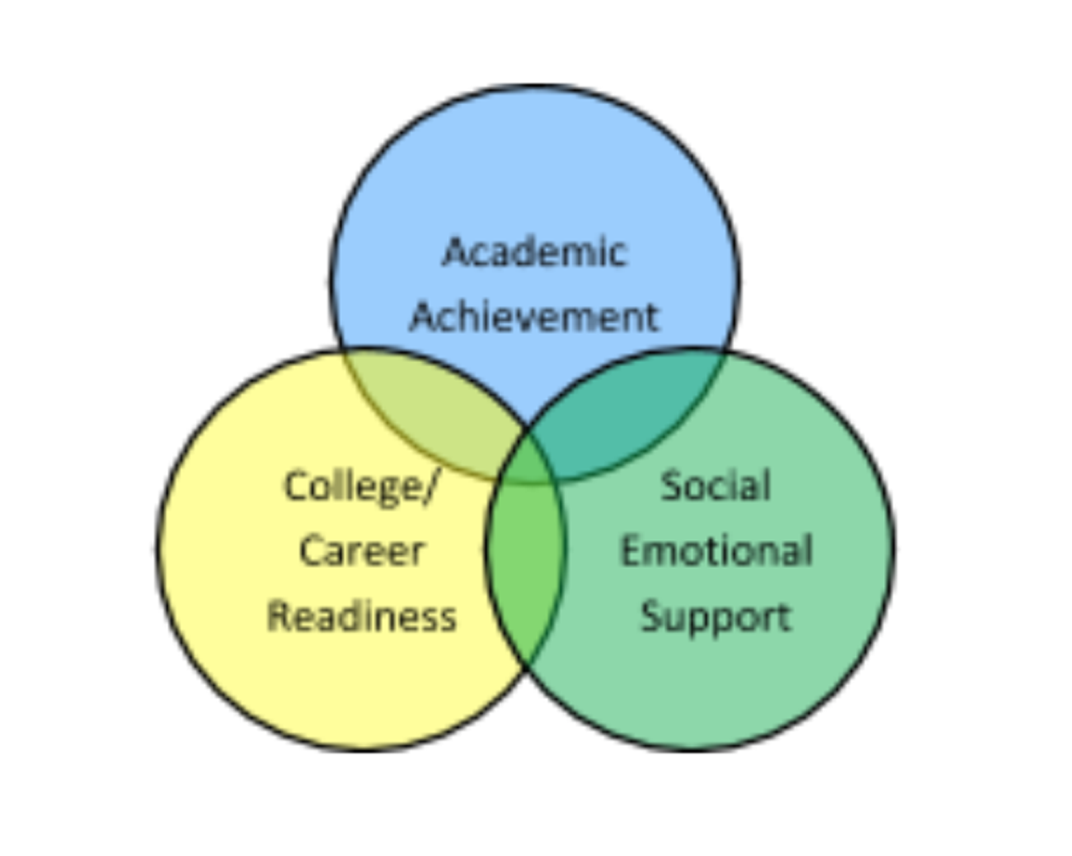
Resources for Additional Support
School counselors help with more than just your student's schedule – see us for any academic, post-secondary or social-emotional concerns, we are here to help.
Meet with your School Counselor | Homework Club Tues 2:15-3:15 | Tutor Lists
Other websites – KhanAcademy.org | Student Assistance Program | Counseling Referrals

Slide 12



Helpful Information
* Found on the Chippewa Valley High School website
Daily Time Schedule
Period Time
1st 7:10 – 8:09 a.m.
2nd 8:15 – 9:14 a.m.
3rd 9:20 – 10:19 a.m.
4th (A) Lunch 10:25 – 10:50 a.m.
Class 10:56 – 11:56 a.m.
(C) Class 10:25 – 11:25 a.m.
Lunch 11:31 – 11:56 a.m.
**Lunch is assigned based on your 4th hour class
5th 12:02 – 1:01 p.m.
6th 1:07 – 2:06 p.m.
Clubs and Organizations – Involved students are more likely to do better in school, have less behavioral problems, and have a more positive high school experience – encourage involvement!
Athletics (Fall, Winter, and Spring sports)
Big Red P.R.I.D.E. Matrix: Prepared, Respectful, Integrity, Dedicated, Engaged

Slide 13
Stay In Touch & Up to Date!
PowerSchool Parent Portal: Keep up with your student’s current grades and attendance. Link found on district website. Login will carry over from middle school. If new to district, you will receive login & password at time of registration.
School Messenger: Weekly updates sent from Principal Williams. Keep contact information updated in order to receive regular messages: phone numbers, email, and home address. **You must have an accurate email in order to receive updates on student’s academic progress.
Schoology: Your students learning platform. Ask your child's teacher for access code
Website https://www.chippewavalleyschools.org/schools/high-schools/cvhs

Slide 14
Registration Materials Due!
Chippewa Valley middle school students are logging in & selecting their elective courses the week of March 18th – 20th Please review all the information with your student as well as with their 8th grade teachers if needed. Contact the appropriate high school counselor with any questions about classes or placement.
If you are planning to enroll your student at CV9 and/or looking to apply for School of Choice, please visit the Chippewa Valley District website and click the Enrollment tab for more information and to complete the application.
Reminder – please have your student choose classes carefully! Changes cannot be made later as the master schedule is built based on students’ selections.

Slide 15
We Look Forward to Seeing You
& Your Future “Big Red” at our CVHS 9th Grade Center!
Mrs. Deborah Wall A-L
Mrs. Jennifer Frohock & Dr. Dan Lawrence M-Z
&
The entire Chippewa Valley High School Staff!
Visit our informational tables on your way out!
*** BIG RED CHECK IN 8/22/24 ***
tentative date – stay tuned

